Slide 1
Objects and Classes
Session 3

Slide 2
The Object Oriented Approach -I
Object oriented programming grew in the 70’s as a solution to the problems of structured programming
Models human thought process as closely as possible
Deals with data and procedures that operate on data as a single ‘object’

Slide 3



The Object Oriented Approach - II
All around us in the real world are objects.
Each object has certain characteristics and exhibits certain behaviour

Slide 4
The Object-Oriented Approach - III
Accounts
Sales
Personnel
The real world around is full of objects .We can consider both living beings as well as things as objects.For example,the different departments in a company are objects.

Slide 5
Drawbacks of Traditional Programming
The drawbacks of Traditional Programming are:
Unmanageable programs
Problems in modification of data
Difficulty in implementation

Slide 6

Why do we care about objects?
Modularity - large software projects can be split up in smaller pieces.
Reuseability - Programs can be assembled from pre-written software components.
Extensibility - New software components can be written or developed from existing ones.

Slide 7
Object – Oriented Programming
Here the application has to implement the entities as they are seen in real life and associate actions and attributes with each.
Data
Employee details
Salary statements
Bills
Vouchers
Reciepts
Accounts
Functions
Calculate salary
Pay salary
Pay bills
Tally accounts
Transact with banks

Slide 8
Object Oriented Approach
Problem Identification
Analysis
Maintenance
Design
Implementation
Development
Testing

Slide 9
Object Oriented Techniques
Object Oriented Techniques
OOA
OOP
OOD

Slide 10
Object Oriented Analysis
Model of the problem
OOA is the phase if any project during which a precise and concise model of the problem in terms of real world objects and concepts as understood by the user is developed

Slide 11
Object Oriented Design
Objects
Programs
OOD is the phase in which programs are organized as cooperative collection of objects , each of which represents an instance of a class, and whose classes are all members of a hierarchy of classes united via inheritance relationship

Slide 12
Object Oriented Programming
OOP (Object oriented Programming) is the construction phase of the life cycle that Object-Oriented Techniques follows
Data:
No. of employees
Salary statements
Bills
Vouchers
Receipts
Petty cash records
Banking data
Accounts
Functions:
Calculate salary
Pay salary
Pay bills
Tally accounts
Transact with
banks
Code & Data
Object

Slide 13
Basic Object Oriented Concepts
Object
Helps to understand the real world
Provides a practical basis for computer applications
Class
Describes a set of related objects
Property
A characteristic of an object – also called attribute
Method
An action performed by an object

Slide 14
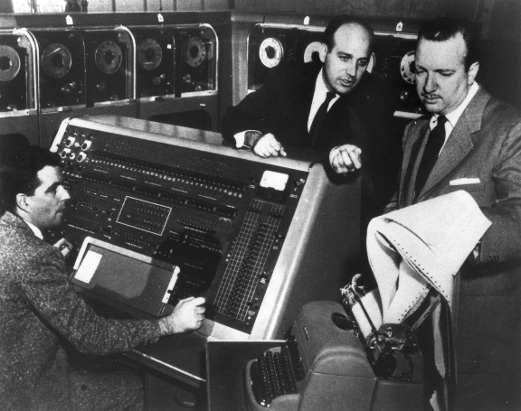
Object-Oriented Programming
Early computers were far less complex than computers are today.
Their memories were smaller and their programs were much simpler.

Slide 15
Object-Oriented Programming
They usually executed only one program at a time.

Slide 16

Object-Oriented Programming
Modern computers are smaller, but far more complex than early computers.
They can execute many programs at the same time.

Slide 17
Object-Oriented Programming
Computer scientists have introduced the notion of objects and object-oriented programming to help manage the growing complexity of modern computers.

Slide 18
Object-Oriented Programming
An object is anything that can be represented by data in a computer’s memory and manipulated by a computer program.

Slide 19

Object-Oriented Programming
An object is anything that can be represented by data in a computer’s memory and manipulated by a computer program.
Numbers

Slide 20

Object-Oriented Programming
An object is anything that can be represented by data in a computer’s memory and manipulated by a computer program.
Text

Slide 21

Object-Oriented Programming
An object is anything that can be represented by data in a computer’s memory and manipulated by a computer program.
Pictures

Slide 22

Object-Oriented Programming
An object is anything that can be represented by data in a computer’s memory and manipulated by a computer program.
Sound

Slide 23

Object-Oriented Programming
An object is anything that can be represented by data in a computer’s memory and manipulated by a computer program.
Video

Slide 24

Object-Oriented Programming
An object is anything that can be represented by data.

Slide 25

Object-Oriented Programming
An object can be something in the physical world or even just an abstract idea.
An airplane, for example, is a physical object that can be manipulated by a computer.

Slide 26

Object-Oriented Programming
An object can be something in the physical world or even just an abstract idea.
A bank transaction is an example of an object that is not physical.

Slide 27

Object-Oriented Programming
To a computer, an object is simply something that can be represented by data in the computer’s memory and manipulated by computer programs.

Slide 28
Object-Oriented Programming
The data that represent the object are organized into a set of properties.
The values stored in an object’s properties at any one time form the state of an object.
Name: PA 3794
Owner: Pakistan International Airline
Location: 39 52′ 06″ N 75 13′ 52″ W
Heading: 271°
Altitude: 19 m
AirSpeed: 0
Make: Boeing
Model: 737
Weight: 32,820 kg

Slide 29
Fields – Declaration
Field Declaration
a type name followed by the field name, and optionally an initialization clause
primitive data type vs. Object reference
boolean, char, byte, short, int, long, float, double
field declarations can be preceded by different modifiers
access control modifiers
static
final

Slide 30
More about field modifiers (1)
Access control modifiers
private: private members are accessible only in the class itself
package: package members are accessible in classes in the same package and the class itself
protected: protected members are accessible in classes in the same package, in subclasses of the class, and in the class itself
public: public members are accessible anywhere the class is accessible

Slide 31
Pencil.java
public class Pencil {
public String color = “red”;
public int length;
public float diameter;
private float price;
public static long nextID = 0;
public void setPrice (float newPrice) {
price = newPrice;
}
}
CreatePencil.java
public class CreatePencil {
public static void main (String args[]){
Pencil p1 = new Pencil();
p1.price = 0.5f;
}
}
%> javac Pencil.java
%> javac CreatePencil.java
CreatePencil.java:4: price has private access in Pencil
p1.price = 0.5f;
^

Slide 32
More about field modifiers (2)
static
only one copy of the static field exists, shared by all objects of this class
can be accessed directly in the class itself
access from outside the class must be preceded by the class name as follows
System.out.println(Pencil.nextID);
or via an object belonging to the class
from outside the class, non-static fields must be accessed through an object reference

Slide 33
public class CreatePencil {
public static void main (String args[]){
Pencil p1 = new Pencil();
Pencil.nextID++;
System.out.println(p1.nextID);
//Result?
Pencil p2 = new Pencil();
Pencil.nextID++;
System.out.println(p2.nextID);
//Result?
System.out.println(p1.nextID);
//Result?
}
}
1
2
still 2!
Note: this code is only for the purpose of showing the usage of static fields. It has POOR design!

Slide 34
More about field modifiers (3)
final
once initialized, the value cannot be changed
often be used to define named constants
static final fields must be initialized when the class is initialized
non-static final fields must be initialized when an object of the class is constructed

Slide 35
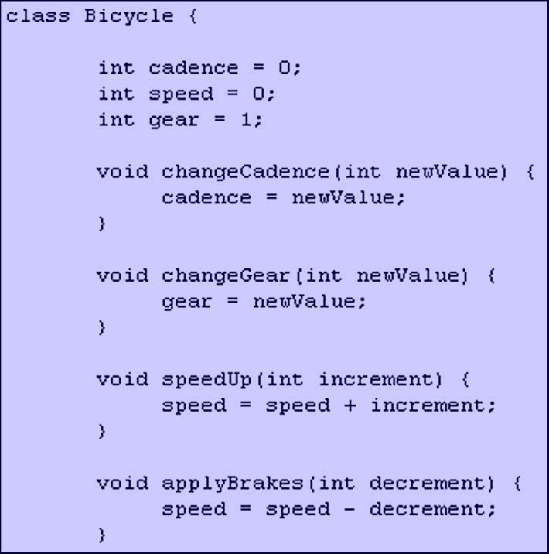
Object-Oriented Programming
Computer programs implement algorithms that manipulate the data.
In object-oriented programming, the programs that manipulate the properties of an object are the object’s methods.

Slide 36
Object-Oriented Programming
We can think of an object as a collection of properties and the methods that are used to manipulate those properties.
Properties
Methods

Slide 37
Methods – Declaration
Method declaration: two parts
method header
consists of modifiers (optional), return type, method name, parameter list and a throws clause (optional)
types of modifiers
access control modifiers
abstract
the method body is empty. E.g.
abstract void sampleMethod( );
static
represent the whole class, no a specific object
can only access static fields and other static methods of the same class
final
cannot be overridden in subclasses
method body

Slide 38
Calling Methods
Communication
Program
Methods
Object
Communication
Methods
Object
Object

Slide 39
Methods – Invocation
Method invocations
invoked as operations on objects/classes using the dot ( . ) operator
reference.method(arguments)
static method:
Outside of the class: “reference” can either be the class name or an object reference belonging to the class
Inside the class: “reference” can be ommitted
non-static method:
“reference” must be an object reference

Slide 40
Calling methods
A method is always called to act on a specific object, not on the class in general
Example:
S1.setdate(27,1,1969)
The general syntax for accessing a member function of a class is
Syntax:
Class.object.method()

Slide 41
Passing Parameters
Passing Parameters
void setDate(int m,int d,int y)
{
day=d;
year=y;
month=m;
}
Formal parameter
Call by value
Call by reference

Slide 42
Call by Value
/* Example of Call by Value */
class Test {
void change(int m,int n)
{
m = m * 2;
n = n + 3;
System.out.println(“The value of m = “+ m + “ and the value of n = “+n);
}
public static void main(String args[])
{
Test S1;
S1=new Test();
int a=10, b=12;
System.out.println(“Before : The value of a = “ +a +“ and the value of b = “ + b);
S1.change(a,b);
System.out.println(“After : The value of a = “ +a + “ and the value of b = “ + b);
}
}

Slide 43
Call by Reference
class Test {
int m,n;
Test() {
m=10;
n=20;
}
void change(Test T1) {
T1.m = T1.m * 2;
T1.n = T1.n + 3;
}
public static void main(String args[]) {
Test S1 = new Test();
Test S2 = S1; //assigning reference of object S1 to S2
System.out.println("Before : The value of m = "+S1.m + "and the value of n = " + S1.n);
S1.change(S2);
System.out.println("After : The value of m = "+ S1.m + " and the value of n = " + S1.n);
}
}

Slide 44
Returning object from a method
A return statement in a function is considered to initialize a variable of the returned type
Syntax:
Test testobjectS1.func()
test func () { test temp_object; . . return temp_object; }

Slide 45
Accessor Functions
Usually the data member are defined in private part of a class – information hiding
Accessor functions are functions that are used to access these private data members
Accessor functions also useful in reducing error

Slide 46
Example – Accessing Data Member
class Student{
…
private int semester;
public void setRollNo(int aSem){
if((aSem<1)||(aSem>8))
System.out.println(“Invalid Semester”);
else
semester = aSem;
}
public int getCurrentSem()
{
return semester;
}
}

Slide 47
Object-Oriented Programming
A class is a group of objects with the same properties and the same methods.

Slide 48

Object-Oriented Programming
Each copy of an object from a particular class is called an instance of the object.

Slide 49

Object-Oriented Programming
The act of creating a new instance of an object is called instantiation.

Slide 50
Object-Oriented Programming
A class can be thought of as a blueprint for instances of an object.

Slide 51
Object-Oriented Programming
Two different instances of the same class will have the same properties, but different values stored in those properties.

Slide 52
Using the Class
class Sdate {
int month, day, year;
void setDate(int m,int d,int y)
{
month=m;
day=d;
year=y;
}
public static void main(String args[])
{
Sdate S1,S2;
S1=new Sdate();
S2=new Sdate();
S1.setdate(11,27,1967);
S2.setdate(4,3,1969);
}
}

Slide 53
Defining Objects
Statement Effect
Sdate S1;
S1
S1 = new Sdate();
S1
Sdate S2 = new Sdate(); S1 object
S2
S2 object
Null
Month (11)
Day (27)
Year (1967)
Month (4)
Day (3)
Year (1969)

Slide 54
Object Reference
Points to
Physical location of data
New operator
create
S1
class Sdate{
………….
……….
Sdate S1 = new Sdate();
Sdate S2 = S1;
………..
}
S1
S2

Slide 55
Class
A Class defines an entity in terms of common characteristics and actions
Class Customer
Name of the customer
Address of the customer
Model of the car bought
Salesman’s name who sold the car
Accept Name
Accept Address
Accept Model of the car purchased
Accept the name of the salesman who sold the car
Generate the bill

Slide 56
Messages
Objects communicate through messages
They send messages (stimuli) by invoking appropriate operations on the target object
The number and kind of messages that can be sent to an object depends upon its interface

Slide 57
Examples – Messages
A Person sends message (stimulus) “stop” to a Car by applying brakes
A Person sends message “place call” to a Phone by pressing appropriate button

Slide 58
Object
Attribute
Characteristic that describes an object
Operation
Service that can be requested of an object
Method
Specification of how the requested operation is carried out
Message
Request for an operation
Event
Stimulus sent from one object to another

Slide 59
Class vs. Object
Class defines an entity, while an object is the actual entity
Class is a conceptual model that defines all the characteristics and actions required of an object, while an object is a real model
Class is a prototype of an object
All objects belonging to the same class have the same characteristics and actions

Slide 60
Class and Objects – Example
class Trainee {
private int empId;
private String empName;
private float basic;
private float hra;
public void SetData(int iEmpId,
String acEmpName, float fBasic,
float fHRA) {
………. }
public void CalculateSal() {
………. }
public void CalculateTax() {
…………}
} //class Trainee ends here
public static void main(String [] args) {
/* Object Creation */
Trainee oT1 = new Trainee();
/* Invoking SetData */
oT1.SetData(101,”Hamza”,1200,150)
/* Invoking CalculateSal */
oT1.CalculateSal();
/* Invoking CalculateTax */
oT1.CalculateTax();
}

Slide 61
Memory allocation for Classes and Objects
class Trainee {
private int m_iEmpId;
private float m_fBasic;
private float m_fHRA;
private float m_fSalary;
public void SetData(int iEmpId, float fBasic,
float fHRA){
}
public void CalculateSal() {
// code goes here
}
public void CalculateTax() {
//code goes here
}
}
Trainee oT1 = new Trainee();
Trainee oT2= new Trainee();

Slide 62
Object-Oriented Programming
Object
Message
Property
The same terminology is used in most object-oriented programming languages.
Instantiation
Method
Class
Instance
State

Slide 63
Message passing in Java is like sending an object i.e. message from one thread to another thread.
State is a behavioral design pattern that allows an object to change the behavior when its internal state changes.
Instance variables in Java are non-static variables which are defined in a class outside any method, constructor or a block
A Java object is a member (also called an instance) of a Java class. Each object has an identity, a behavior and a state.
A class is a non-primitive or user-defined data type in Java, while an object is an instance of a class

Slide 64
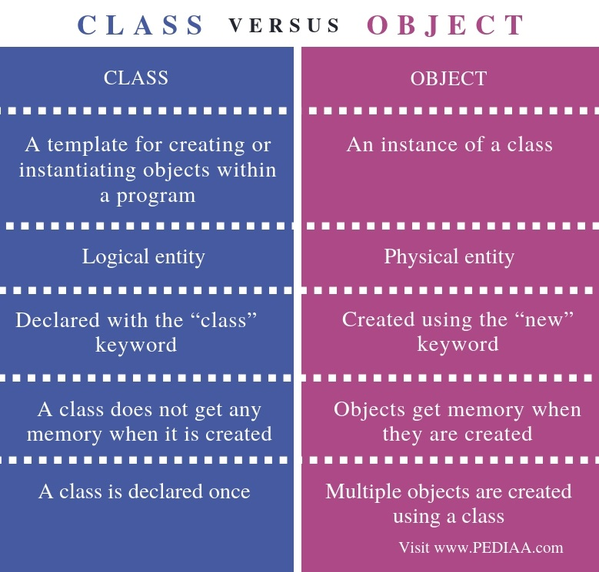
An event in Java is an object that is created when something changes within a graphical user interface.

Slide 65
